Slide 1
DATABASE MANAGEMENT SYSTEM
NAME:UTKARSH BHATT
ROLL NO:21IE10041

Slide 2
What is DBMS ?
Organized collection of interrelated data of an enterprise.
Set of programs to access and manage data.
Environment that is convenient and efficient to use.

Slide 3
DISADVANTAGES OF FILE SYSTEM OVER DBMS
Atomicity of updates
Redundancy
Inconsistency
Difficulty in accessing data
Data isolation problem
Integrity problems
Concurrent access

Slide 4
There are many types of Databases
We are going to focus on two
RDBMS
NoSQL

Slide 5
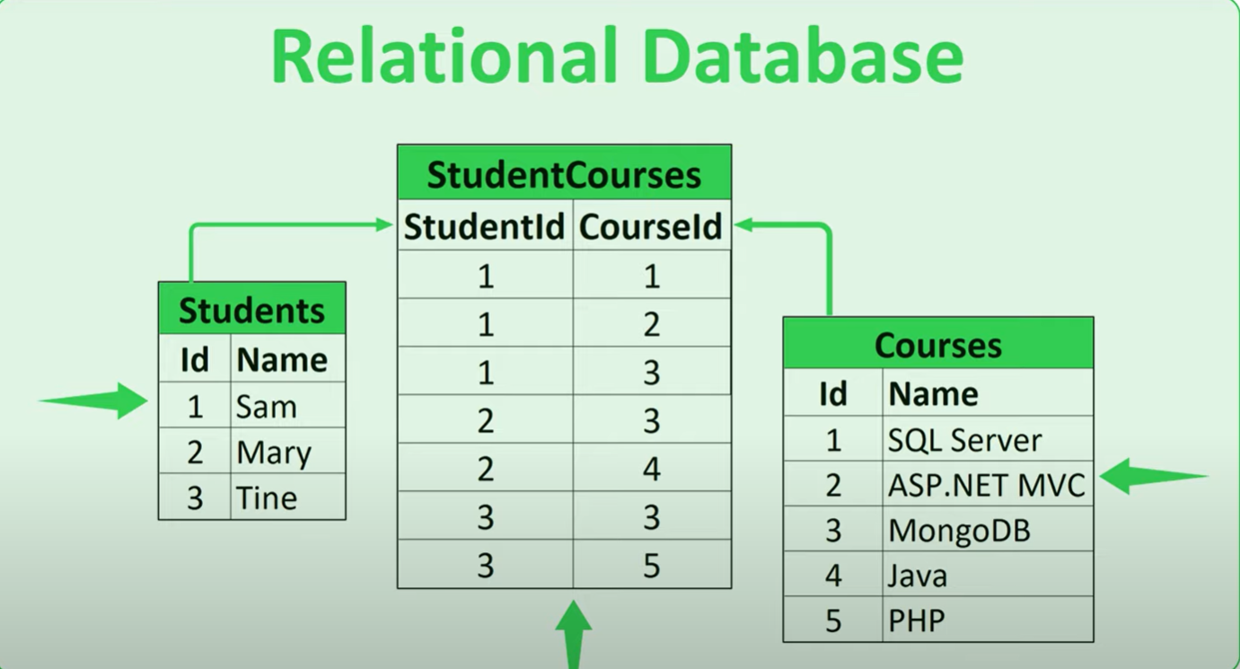
RELATIONAL DATABASES
Example : Oracle,MySQL,PostgreSQL

Slide 6
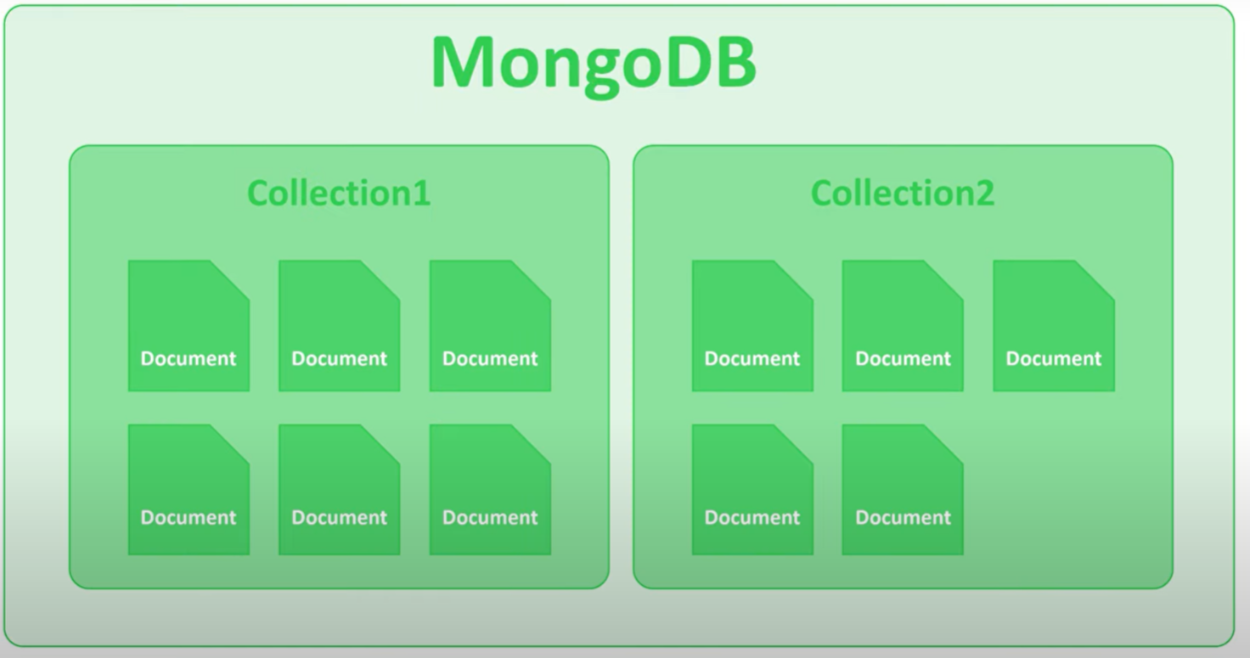
NoSQL database
Examples : MongoDB,CouchDB,Graph,Amazon Neptune

Slide 7
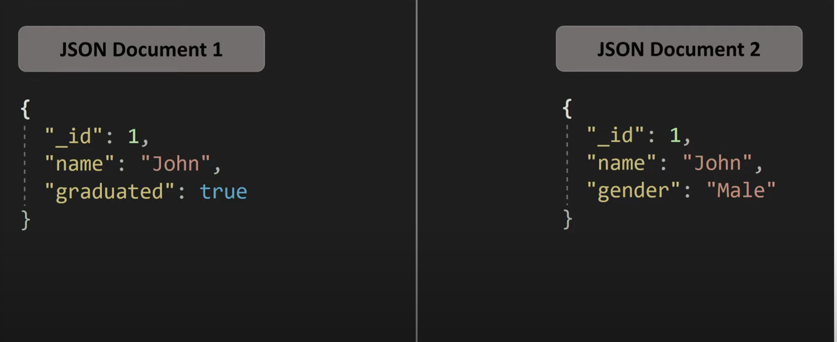

Slide 8
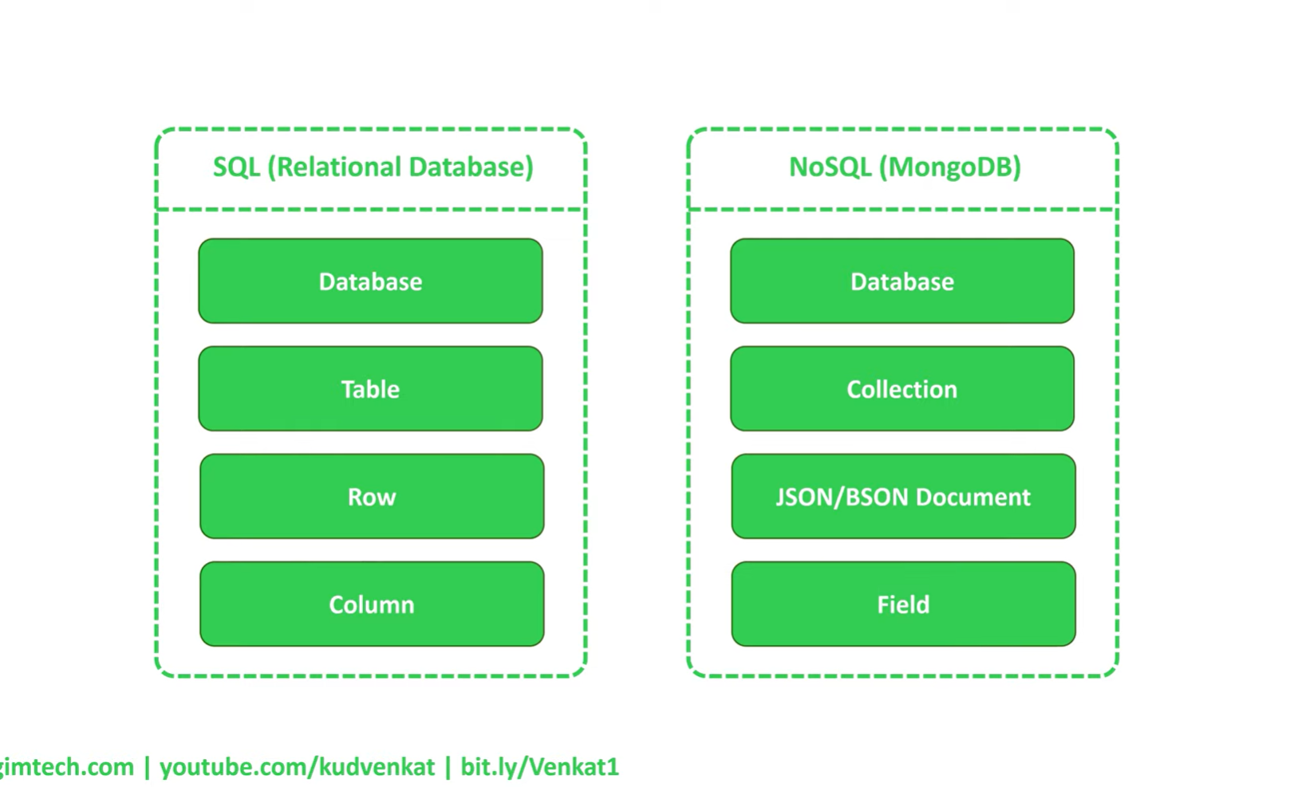
COMPARATIVE STUDY BETWEEN RELATIONAL DATABASE AND noSQL DATABASE

Slide 9
Advantages of NoSQL over Relational Database
NoSQL can work with both structured and unstructured complex data.
NoSQL have a dynamic schema thereby much easier to update.
Relational databases are expensive to scale.
Queries are generally faster in NoSQL Databases.

Slide 10
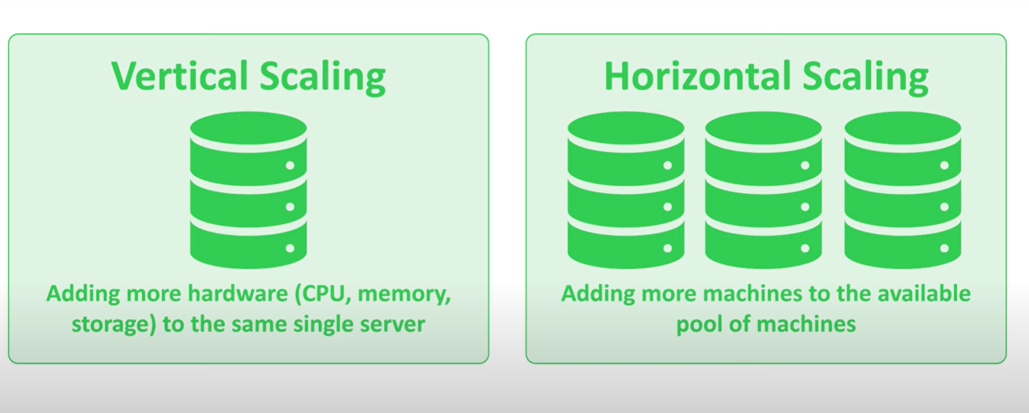
RDBMS are vertically scalable whereas NoSQL are horizontally scalable
Vertical Scaling is Expensive

Slide 11
Disadvantages of NoSQL over Relational Database
NoSQL are generally larger than SQL databases because of data duplication.

Slide 12
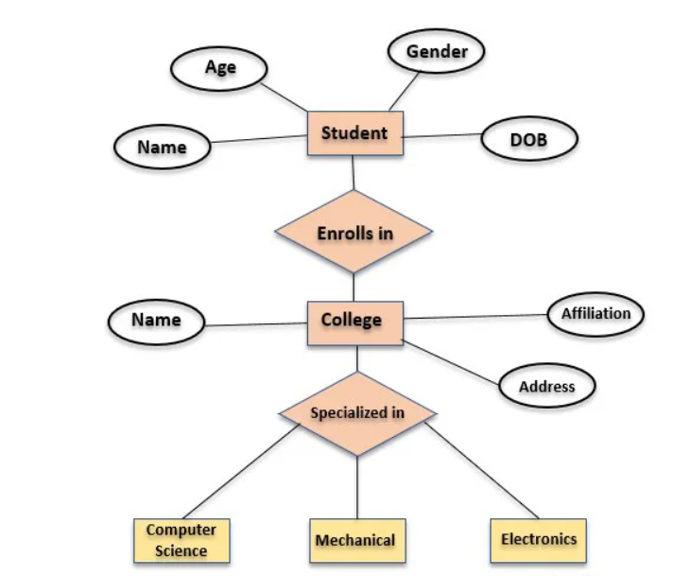
ER DIAGRAM
The entities represent all the tables of the database,attributes are the columns of the table and the relationship represents the association among the tables of a database.

Slide 13
COMPONENTS OF ER DIAGRAM
Entity
Attribute

Slide 14
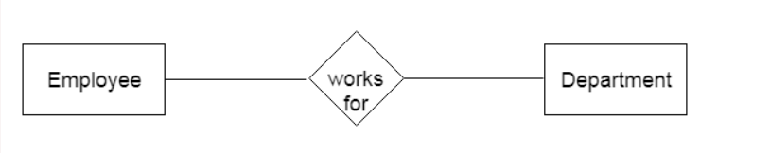
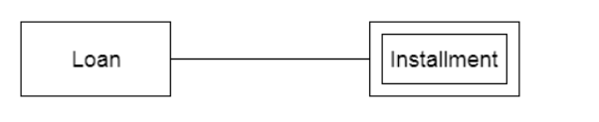
ENTITY
ENTITY
WEAK ENTITY

Slide 15
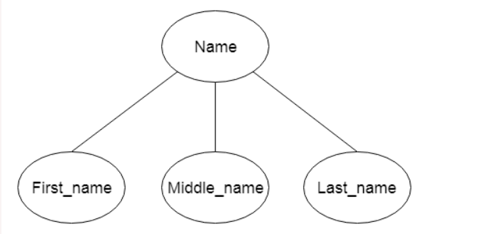
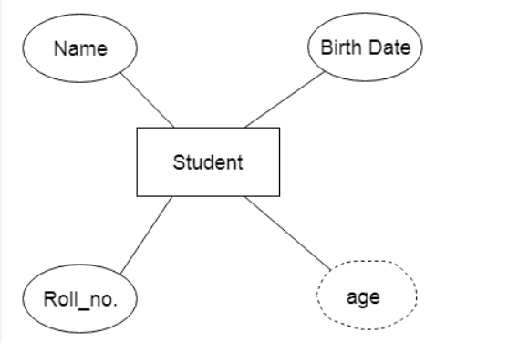
ATTRIBUTE
Composite Attribute
Derived attribute

Slide 16
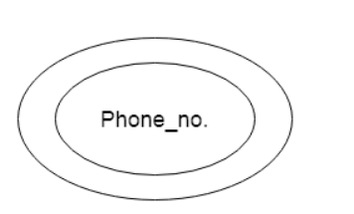
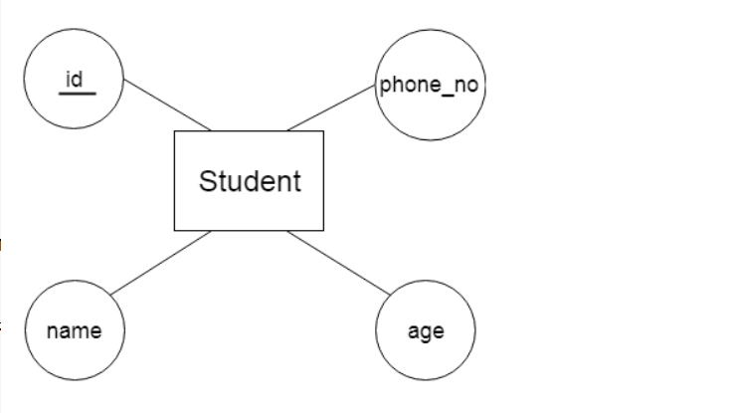
Multivalued Attribute
Key Attribute

Slide 17
KEYS
A Key is an attribute or a set of attributes that uniquely identifies any record from the table.

Slide 18
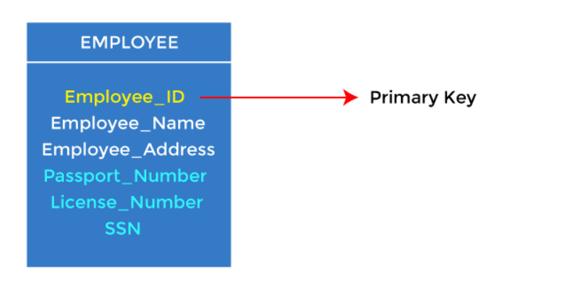
TYPES OF KEYS:
PRIMARY KEY
It is the first key used to identify one and only one instance of an entity uniquely. An entity can contain multiple keys.. The key which is most suitable from those lists becomes a primary key.

Slide 19
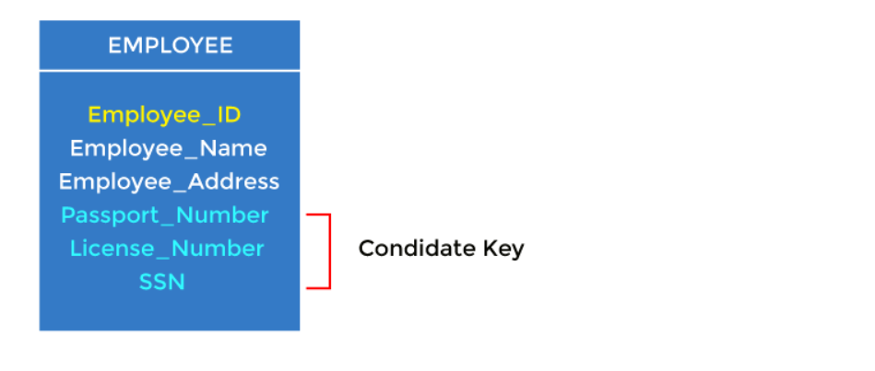
CANDIDATE KEY
Except for the primary key, the remaining attributes are considered a candidate key. The candidate keys are as strong as the primary key.

Slide 20
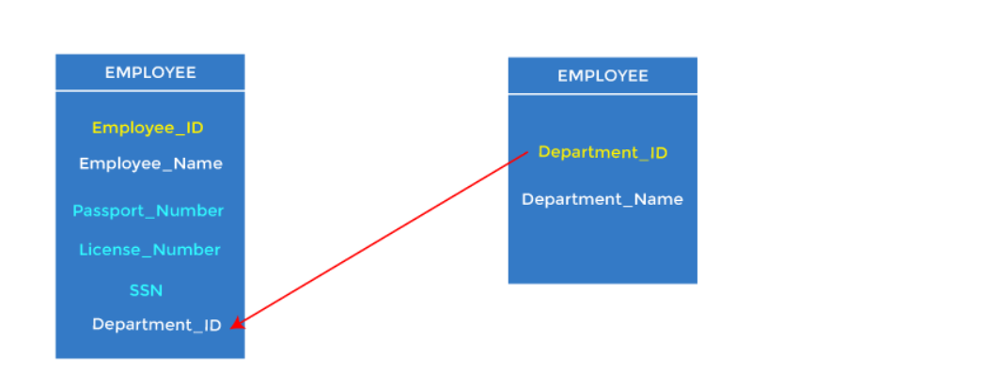
FOREIGN KEY
Foreign keys are the column of the table used to point to the primary key of another table.

Slide 21
ALTERNATE KEY
All the candidate keys except the primary key are known as alternate keys.
SUPER KEY
It is an attribute set that can uniquely identify a record.

Slide 22
TYPES OF RELATIONS IN A DATABASE TABLE
ONE TO ONE
ONE TO MANY
MANY TO ONE
MANY TO MANY

Slide 23
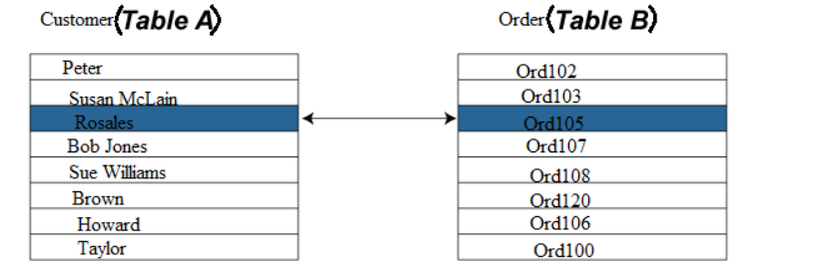
ONE TO ONE

Slide 24
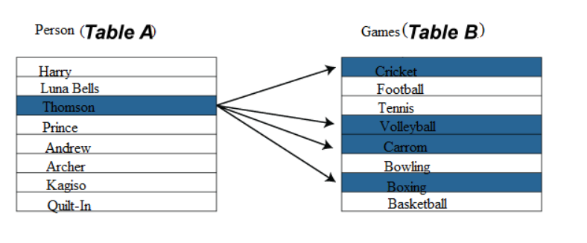
ONE TO MANY

Slide 25
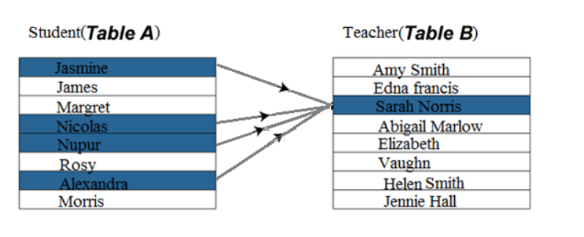
MANY TO ONE

Slide 26
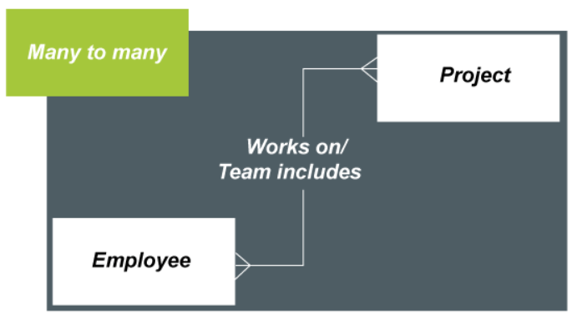
MANY TO MANY

